Slide 1
Group 2
Thom Overhand, Paul de Keijzer, Timo van Werkhoven, Stef Gelderblom, Marcel Bostelaar

Slide 2
The project
Features
Development tools
Techniques
Problems we encountered
Demo
Personal contribution

Slide 3
Features
Filtering items
Register / login
User wish lists

Slide 4






Development tools

Slide 5
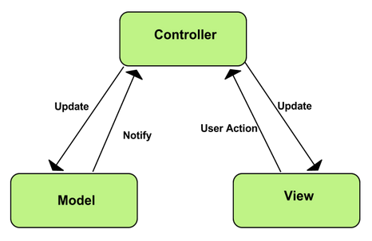
Techniques
MVC

Slide 6
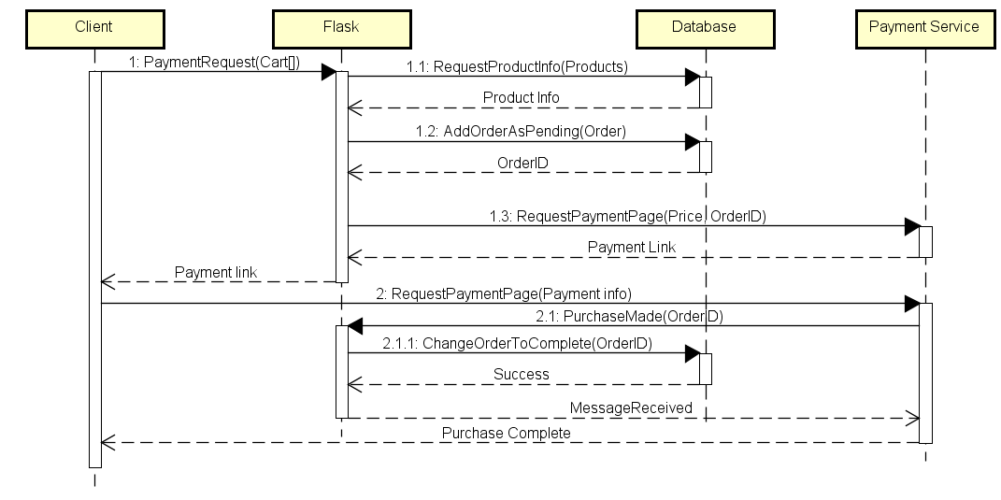
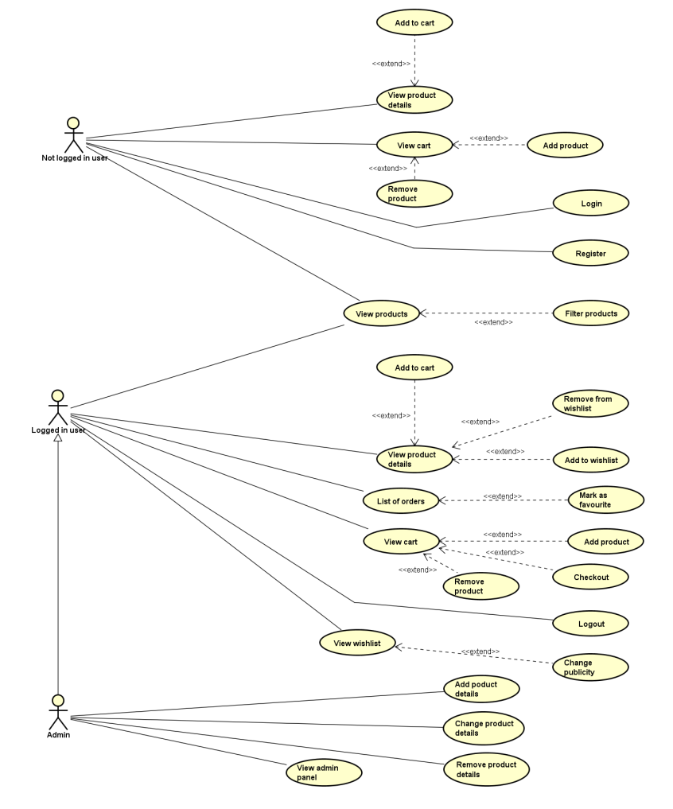
Technical diagrams

Slide 7
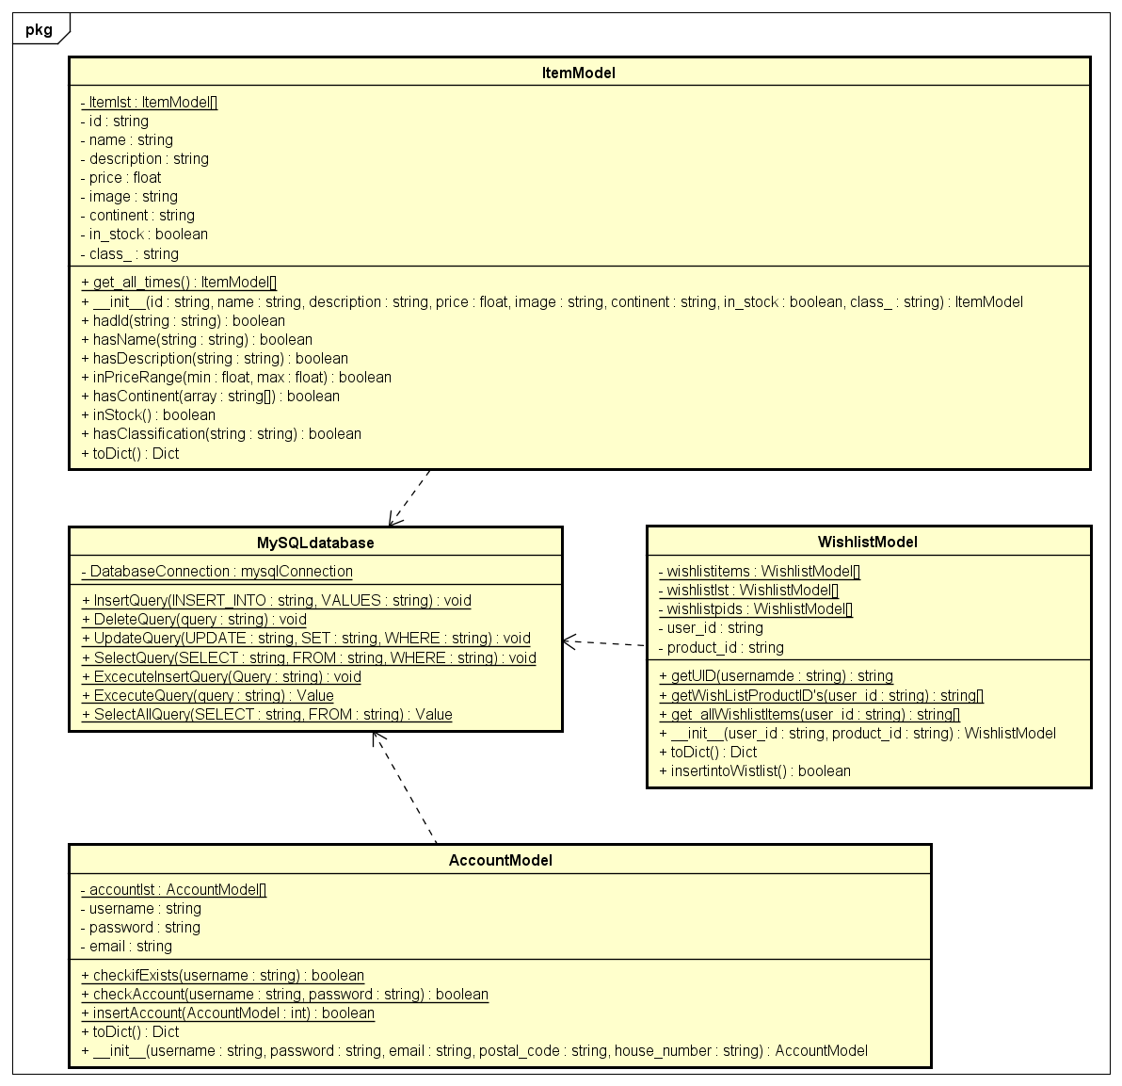
Technical diagrams

Slide 8
Problems we encountered
No one with web development experience.

Slide 9
Demo

Slide 10
Personal contributions
Timo
Stef
Thom
Paul
Marcel

Slide 11

Nog vragen?

